Slide 1
Superstore Marketing Analysis "Analyzing sales and customer behavior to drive targeted marketing strategies"
Name: Sandra Joseph

Slide 2
Problem Statement:
Superstore generates large volumes of sales and customer data across multiple regions and product categories. However, without proper analysis, valuable insights into customer behavior, sales trends, and marketing effectiveness remain hidden. This project aims to clean, analyze, and visualize the dataset to identify patterns, segment customers based on recency, and provide actionable recommendations for improving marketing strategies and business performance.

Slide 3
Dataset Overview
Source:Superstore_Marketing_Dataset- https://www.kaggle.com/datasets/ahsan81/superstore-marketing-campaign-dataset
Rows: 2,240 records
Columns: 22 features
Data Type: Mix of numerical and categorical data

Slide 4
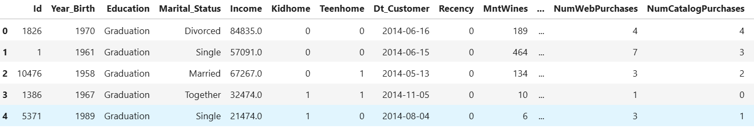
Key Columns
Recency-Days since last purchase- Helps identify how recently a customer engagedIncome-
Income-Allows segmentation based on spending power.
MntWines,MntFruits,MntMeatProducts,etc-Amount spent in product categories. Shows purchase preferences, enabling product-level targeting
NumWebPurchases,NumStorePurchases, NumCatalogPurchases-Purchases through different channels-Reveals preferred shopping channels
Response-Whether customer responded to the campaign

Slide 5
Data Cleaning
Removed 24 rows with missing values in Income. Removed Duplicates
Standardized text formats: capitalized first letter, changed
Checked for and confirmed no duplicate rows
Created Recency_Segment column:Active: ≤ 30 days, Warm: 31–60 days, Dormant: > 60 days
Exported cleaned files
Loaded Raw Data
Handled Missing Values
Standardized Text Formatting
Removed Duplicates
Corrected Marital Status Entries
Created New Feature
Saved Cleaned Data

Slide 6
Recency Segmentation
Definition: Number of days since a customer’s last purchase.
Purpose: Helps group customers by recent activity for targeted marketing.
Segments Created:
Active → Last purchase within 30 days
Warm → Last purchase between 31–60 days
Dormant → No purchase in over 60 days
Insight: Majority of customers fall into the Warm category.

Slide 7
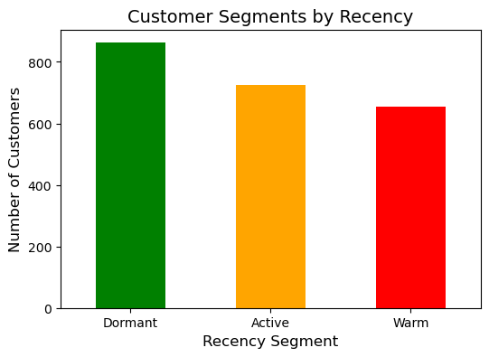
EDA Visualizations
- The Dormant segment has the highest number of customers, approximately 750.- The Active segment has around 650 customers.- The Warm segment has about 600 customers.

Slide 8
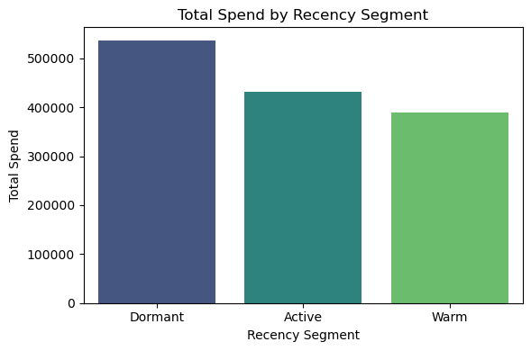
Dormant customers have the highest total spend. Active customers have a significant total spend. Warm customers have a lower total spend.

Slide 9
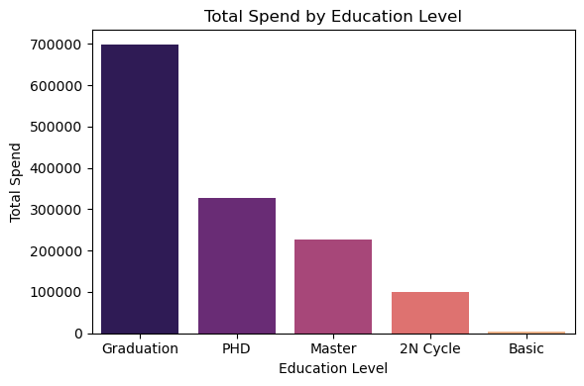
- Highest Total Spend: Customers with a "Graduation" education level have the highest total spend, approximately 600,000.- Decreasing Total Spend: Total spend decreases as education level increases beyond "Graduation."- Lower Total Spend for Higher Education: "PHD" and "Master" education levels have lower total spends compared to "Graduation."- Lowest Total Spend: "2N Cycle" has the lowest total spend among the recorded education levels, around 100,000.- No Spend for Basic Education: No total spend is recorded for customers with a "Basic" education level.

Slide 10
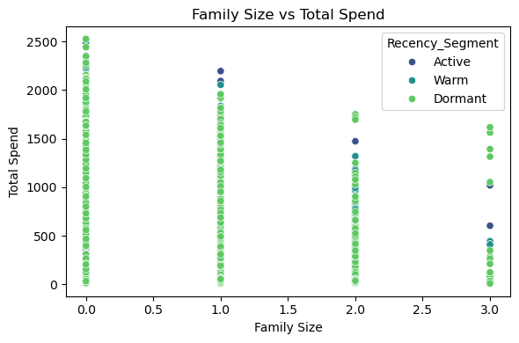
- Family sizes 0, 1, and 3 are the most common. - Highest total spend is observed for family sizes 0 and 1. - Most customers are in the "Warm" recency segment. - Total spend is skewed towards lower values.- Visuals: The scatter plot illustrating the relationship between family size and total spend.

Slide 11
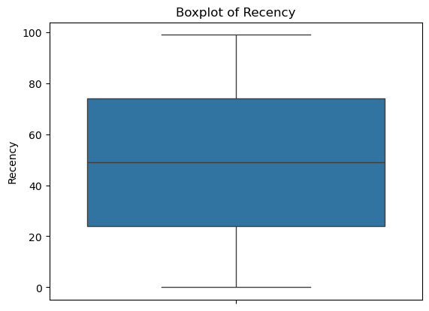
- Median recency value is around 50. - IQR is approximately 20-30. - No outliers visible in the plot. - Recency values are relatively evenly distributed.

Slide 12
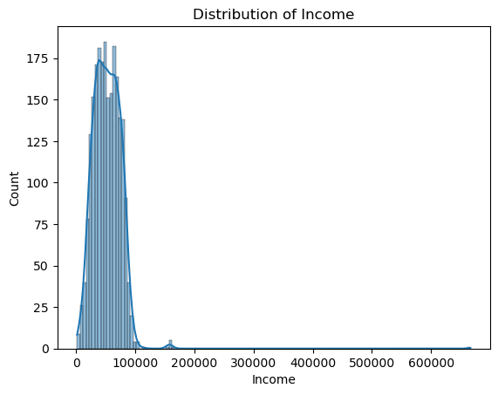
- The distribution of income is positively skewed.- Most individuals have incomes below 100,000.- The majority of individuals have incomes between 50,000 and 75,000.- There are a few outliers with incomes above 200,000.

Slide 13
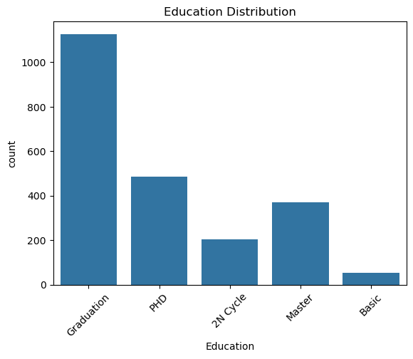
- Majority of the population has a "Graduation" level of education. - Significant presence of "PhD" and "Master" education levels. - Relatively low count for "Basic" education level. - "2nd Cycle" education level has a lower count compared to "Graduation" and "Master."

Slide 14
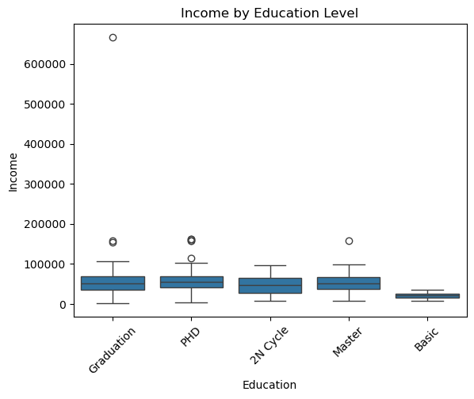
- General increase in income with higher education levels - Fluctuations in income for certain education levels - Highest income associated with Master education level - Lowest income associated with Basic education level

Slide 15
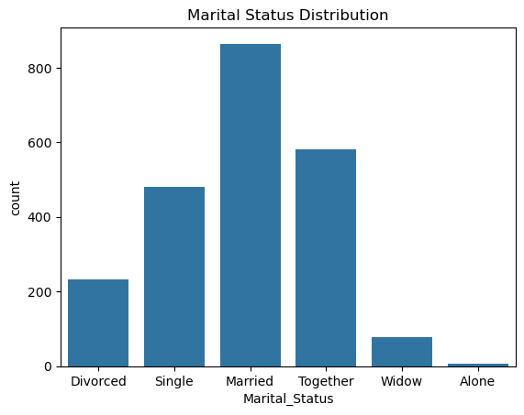
Majority of customers are Married, representing the largest group. Significant portion of customers are Single or Together. Smaller groups include Divorced, Widow, and Alone. Cleaned data by replacing unusual entries ("YOLO" and "Absurd") with Alone

Slide 16
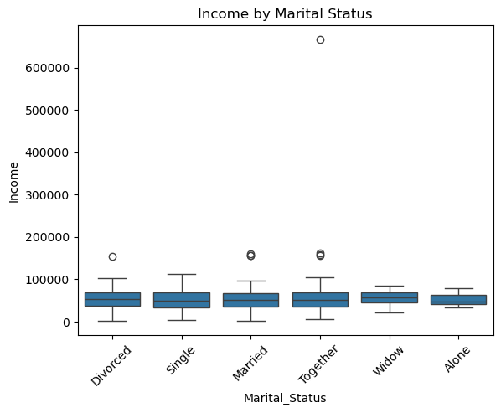
- Median income is relatively consistent across different marital statuses Median income levels for Divorced, Single, Married, Together, Widow, and Alone are relatively close. Outliers exist in the Married and Together groups, indicating a few individuals with exceptionally high income. This suggests income disparities are present but not widespread across marital categories.

Slide 17
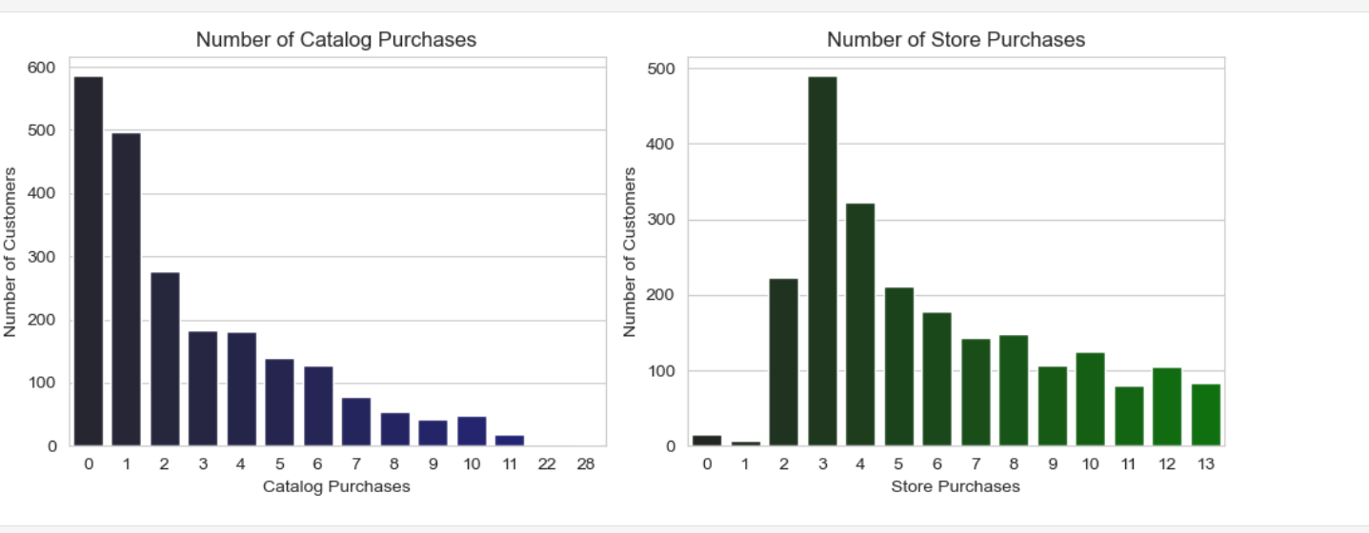
Most customers made 0 or 1 catalog purchase, indicating low catalog engagement.
Store purchases are more concentrated around 2 to 4 purchases, showing higher store activity.
Catalog purchase counts drop sharply after 1, whereas store purchases have a wider distribution.
These insights suggest tailored approaches to improve catalog customer engagement and maintain store purchase frequency.

Slide 18
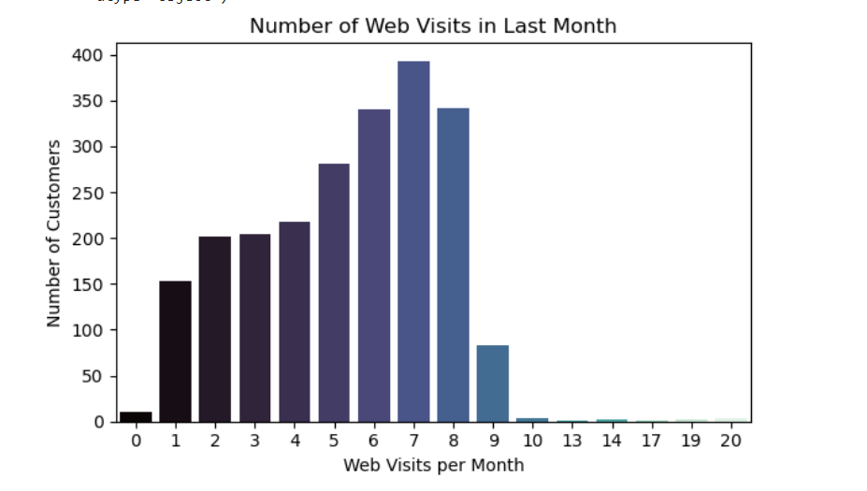
The distribution of web visits in the last month shows that most customers visited the website between 5 to 8 times, with the peak at 7 visits. Very few customers had 0 visits, indicating generally active user engagement. Visits beyond 9 times per month are rare, suggesting that extremely frequent visitors are uncommon. This pattern highlights a moderately engaged customer base, with potential opportunities to re-engage those visiting 0–2 times and further nurture the highly active segment visiting 6–8 times per month.

Slide 19
Key Insights from the Analysis
Recency Segments 🎯 Dormant customers have highest spent and most customers. 🔥Warm segment has many customers but lowest total spend.
🎓Education Graduation level: most common and highest spending group. Higher education (Master/PhD) → no clear link to higher spending.
❤️ Marital Status Married customers are the most numerous. Income is evenly distributed across all statuses with a few high earners.
👨‍👩‍👧 Family Size Smaller families (0–1) → higher spending. Larger families (2–3) → lower spend.

Slide 20
📅Recency Distribution Recency values are spread out evenly, no major outliers.
🌐 Web Visits per Month Most customers visit 5–8 times, peaking at 7 visits, Few customers visit more than 9 times, Opportunity to re-engage low-frequency visitors
🛒 Purchase Channels: Most customers make 0-1 catalog purchases, with very few making many purchases via catalog Store purchases peak around 3–4 purchases, with a wider spread of customers making multiple store purchases

Slide 21
Suggested Actions for Improvement
Re-activate Dormant Customers-High priority Send targeted loyalty or win-back offers to high-value dormant users.
Boost Warm Segment Engagement-High priority Launch campaigns to convert "Warm" customers into Active. Use reminders, personalized recommendations, and offers.
Focus on Graduate-Level Segment-Medium priority Prioritize campaigns for Graduation-level education group (largest & highest spenders).
Family-Oriented Offers-Medium priority Create personalized campaigns for smaller households (0–1 family size). onsider special bundles or deals for larger families to increase engagement.
Marital Status Personalization-Low priority Use relationship-based targeting for "Married" and "Together" segments.
Leverage Web Visit Behavior-Medium priority Re-engage low-frequency visitors (0–2 visits/month) with targeted nudges. Reward highly engaged users (5–8 visits/month) with loyalty incentives or exclusive online offers.

Slide 22
Conclusion
Behavioral differences across segments highlight opportunities to tailor marketing: Dormant customers show high spend potential, graduation-level education drives strong value, and smaller families spend more. Additionally, catalog purchases are low overall, with most customers making few purchases, while store purchases have more frequent engagement, peaking around 3–4 purchases per customer.
Website engagement trends reveal most active customers visit 5–8 times monthly; low-frequency visitors offer reactivation potential.
Focusing on dormant users, engaged visitors, graduation-level education, family size, and purchase channels can maximize ROI.(Return on Investment)
Next Steps: Target dormant and low-visit users with win-back offers Personalize campaigns based on web activity, education level, and preferred purchase channels Monitor and refine strategies for key segments

